Slide 1
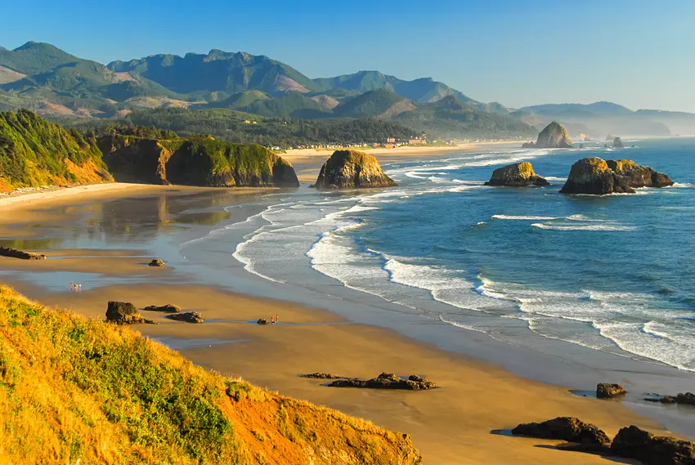
Presentation to the Cottage Grove CDC
June 4, 2021
Partnering with the City of Oakridge to Build
A Sustainable Entrepreneurial Ecosystem & Economy
www.oregonrain.org
Building Inclusive Entrepreneurial Ecosystems in Oregon

Slide 2
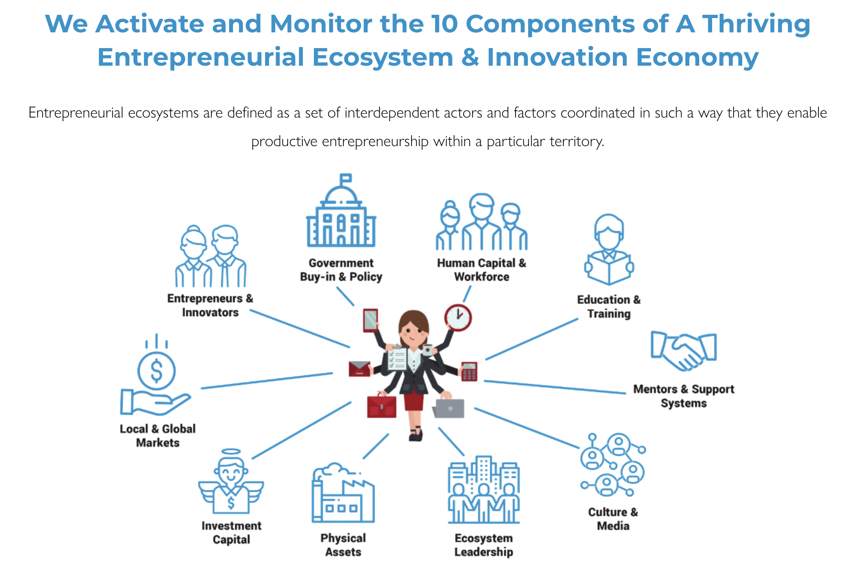
Monitor & Support Oakridge’s E&I Ecosystem
Notes:
Monitor and fill gaps

Slide 3
TOOLKIT W/ 50+ ASSETS
www.oregonrain.org
Building Inclusive Entrepreneurial Ecosystems in Oregon

Slide 4
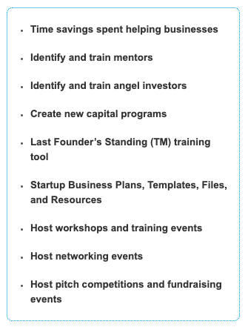
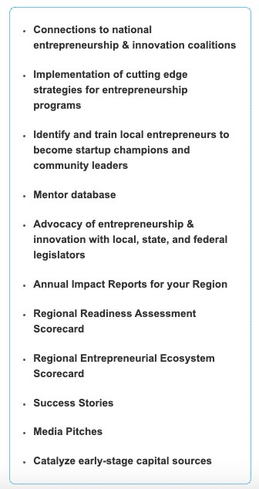
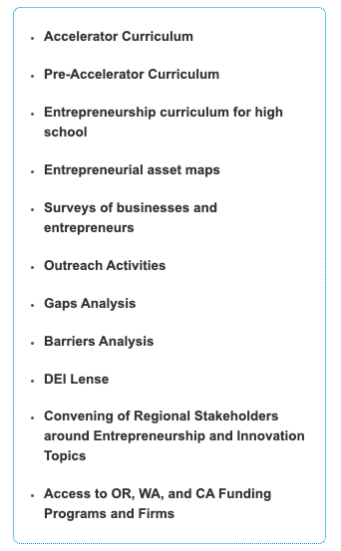

Slide 5
Only enter Communities who Invite us in!
Oakridge ($20,000) – 2 year MOU (pop = 3500)
Lowell ($20,000) – 2 year MOU (pop = 1200)
Veneta ($20,000) – 2 year MOU (pop = 5K)
Cottage Grove ($70,000) – 2 year MOU (pop = 11K)
Creswell ($140,000) – 5 year MOU (pop = 6K)
Florence ($74,000) – 2 year MOU (pop = 10K)
3 Rural Cities in Grant County, OR ($44,000) – 2 year MOU (pop = 7200)
8 Rural Cities in Skagit County, WA ($300,000) – 2 year MOU (pop = 131K)
12 Rural Cities in Linn/Benton Counties, OR ($132,000) – 2 year MOU (pop = 109K)
Notes:
Monitor and fill gaps

Slide 6
Funds Leveraged to Support E&I in Oakridge
Lane County
State of Oregon (Business Oregon)
US Department of Agriculture
US Economic Development Administration
The Collins Foundation

Slide 7
Entrepreneur & Community Support
Sampling of Support over the last year in Oakridge:
SweetVine
Brock’s Woodlot
Marbalous Art
SoMetal
Mane Street Coffee
Lady Sourdough
ArtWorks
Flying Dog Gallery
UBRA
Oakridge Lodge
Oakridge Cascade
The Corner Bar
Urban Market & Salvage
SWFC
Casey’s RV Park
OW Chamber of Commerce
WOLFH
City of Oakridge
Happy Belly Burgers
Cascades to Coast Home Inspection
Sizzling Hot Pizza
Sunshine Landscaping

Slide 8
What Oakridge Entrepreneurs are Saying:
Services RAIN Catalysts Has Provided:
Provided Financial Sponsorship for Marketing/Events
Free Mentoring
Free Educational Workshops & Meetups
Free Digital Marketing Workshops
Connections with other Rural Entrepreneurs in Lane, Linn, and Benton Counties
Services Still Needed:
Raising Capital
Financial Literacy
Pricing Goods & Services
Understanding Codes & Regulations
Jobs Created/To Be Created From These Three Entrepreneurs 11
(See Entrepreneur Letters in Packet)
Notes:
On jobs I would emphasise these three entrepreneurs ALONE are creating 11 jobs

Slide 9
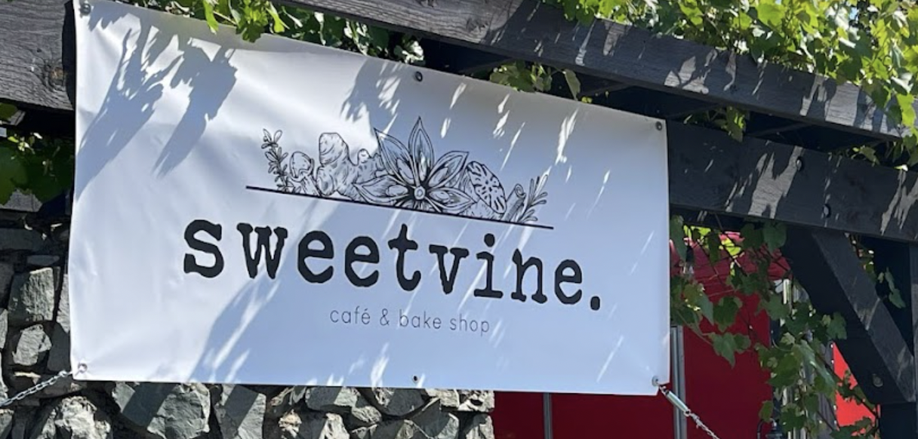
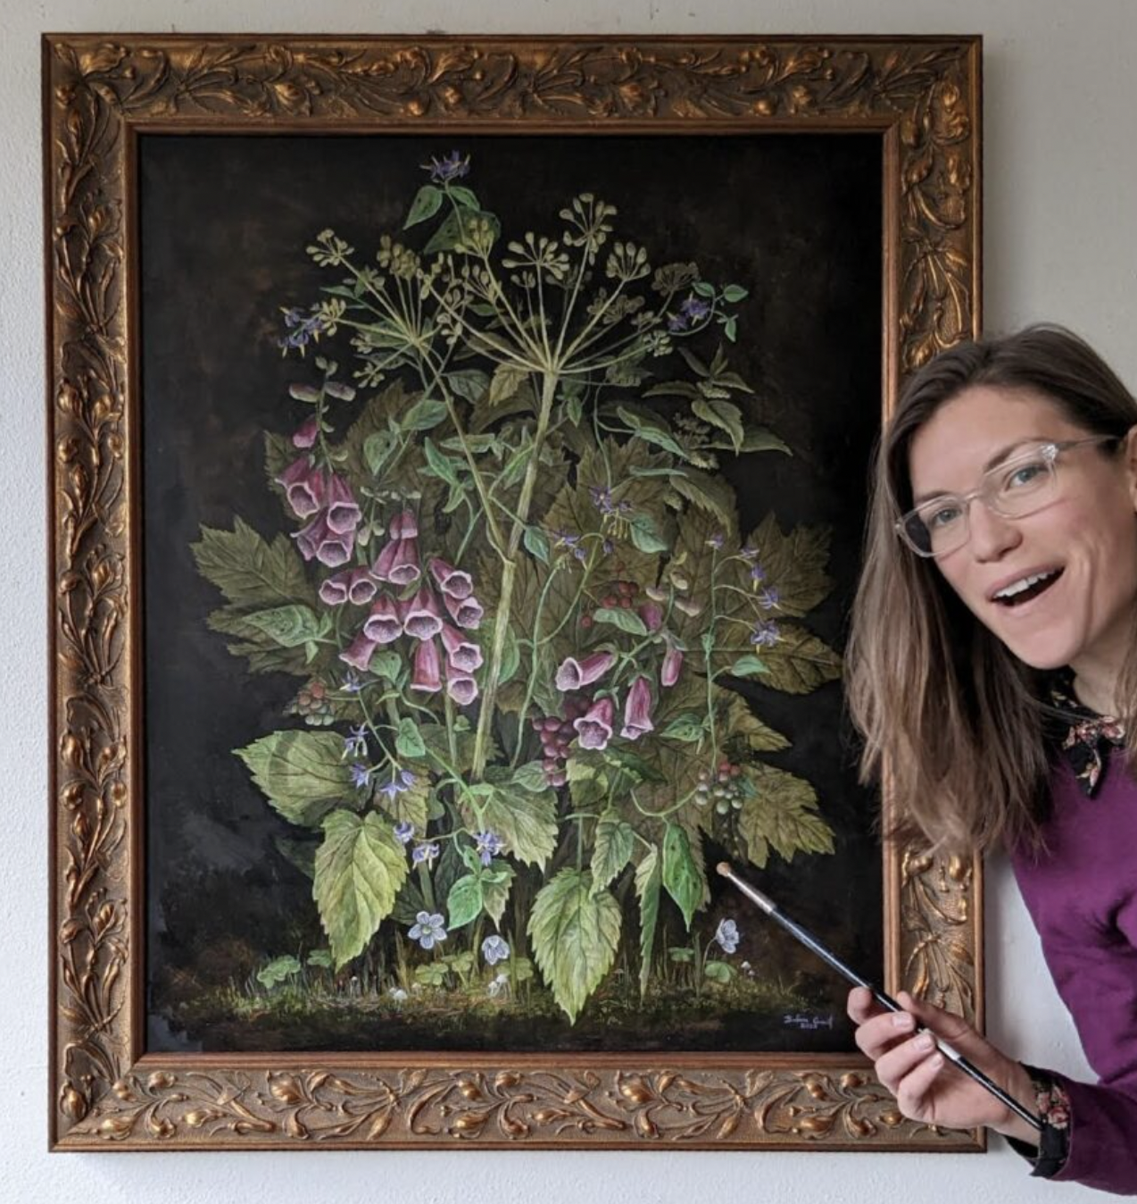
What Oakridge Entrepreneurs are Saying:
“It is important to small businesses like mine to have the “big city” resources that RAIN Catalysts brings to our rural community.”
– Michelle Slaven, Sweetvine
“[RAIN has] provided financial sponsorship for marketing/events and connected me to other rural entrepreneurs in the region.”
– Barbara Counsil Burney, Barbara Counsil Art & Illustration

Slide 10
Grants & Letters of Support
RAIN Catalysts Directly Supported the City of Oakridge for the Following
The RISE Grant
The Industrial Lands Grant
Letters of Support Have Been Written for the Following
WAC Funding Committee
Oakridge Industrial Park
WOLFH (Westfir Oakridge Local Food Hub)
City of Oakridge Technical Assistance Grant

Slide 11
What’s Next…
April & May:
🚗 Virtual/Hybrid Offering of Destination Creation Course
This is a proprietary curriculum valued at $800 per attendee offered free of charge to 17 businesses or community organizations in Oakridge/Westfir and Lowell.
🌼 Spring Into New Business!
A day long seminar at the Golf Course featuring
Choose Your Business Entity and its Tax Implications
Mini Pre-StartUp Accelerator
Digital Marketing (Free & Paid) for Your Business

Slide 12
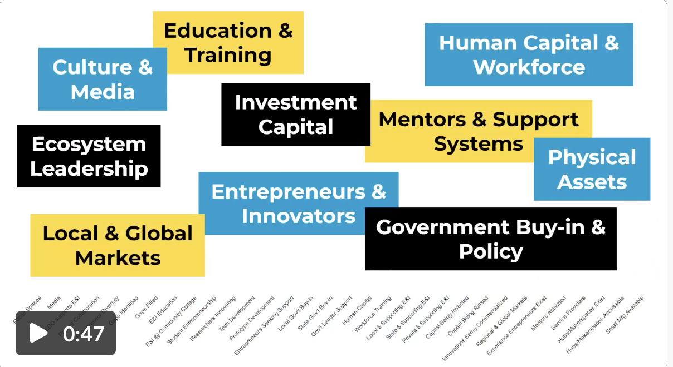
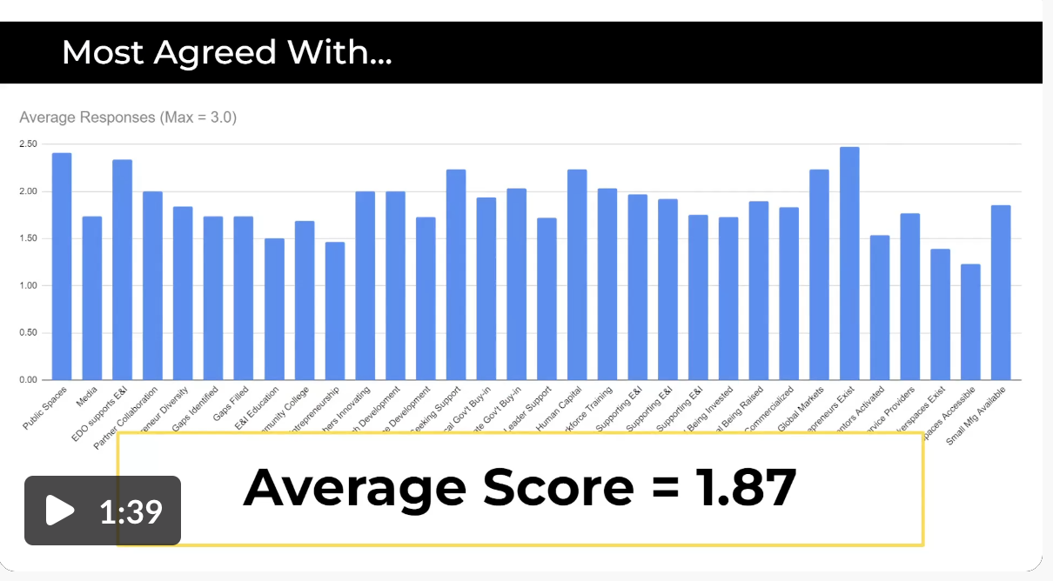
What’s Next…
May & June:
City of Oakridge’s Entrepreneurial Ecosystem Assessment
Surveying key stakeholders on the “10 elements of a thriving E&I economy”
Report back to stakeholders:
Areas growing/thriving
Areas for Improvement
Gaps
Suggestions for filling gaps (who and when…)

